Slide 1
Network DEA in Insurance Industry
吳延東

Slide 2
產險、壽險 | Z1 no split | Z1 split
CRS
VRS |  | 時間（5 年）

Slide 3
產險、壽險 | Z1 no split | Z1 split
CRS
VRS |  | 時間（5 年）

Slide 4
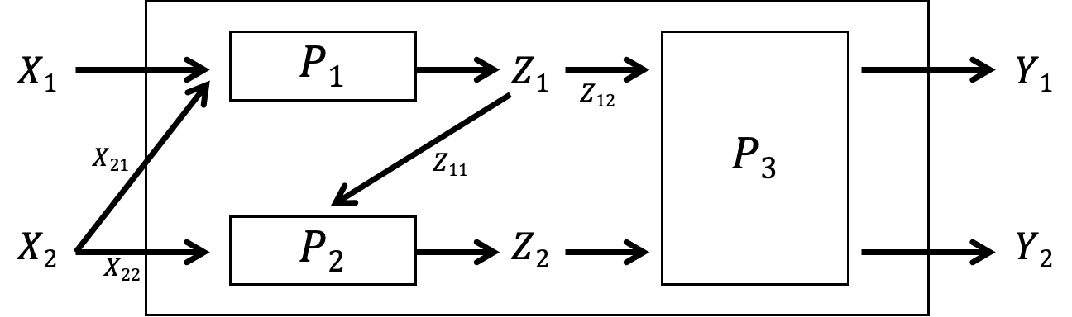
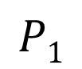
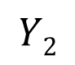
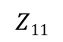
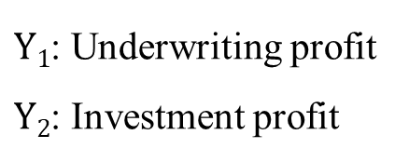
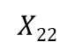
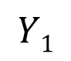
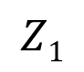
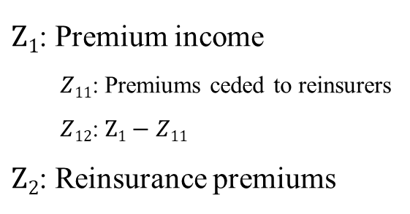
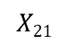
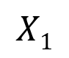
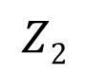
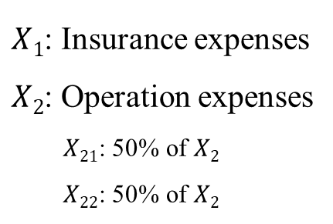
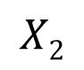
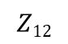
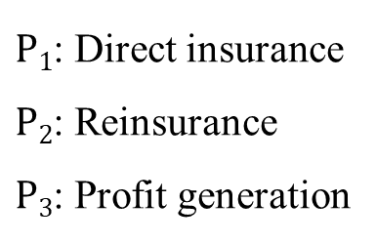
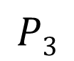
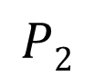
Revised network DEA model
Network DEA in Insurance Industry
(CRS)
Notations:
$X1$: Insurance expenses
$X2$: Operation expenses
$X21$: 50% of $X2$
$X22$: 50% of $X2$
$Z1$: Premium income
$Z11$: Premiums ceded to reinsurers
$Z12$: $Z1−Z11$
$Z2$: Reinsurance premiums
$P1$: Direct insurance
$P2$: Reinsurance
$P3$: Profit generation
$Y1$: Underwriting profit
$Y2$: Investment profit
$$X1$$
$$P1$$
$$Z1$$
$$Y1$$
$$Z12$$
$$X21$$
$$P3$$
$$Z11$$
$$X2$$
$$P2$$
$$Z2$$
$$Y2$$
$$X22$$

Slide 5
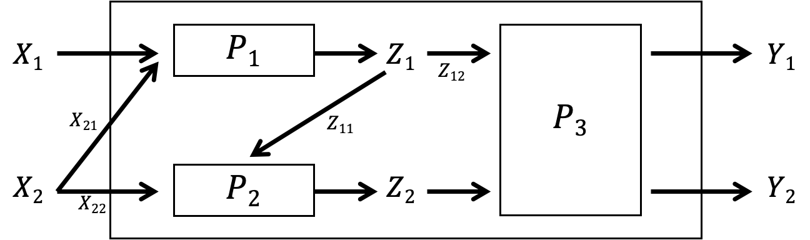
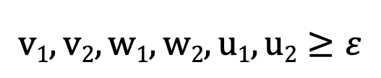
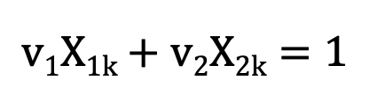
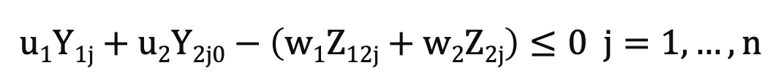
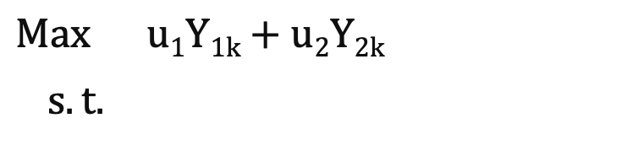
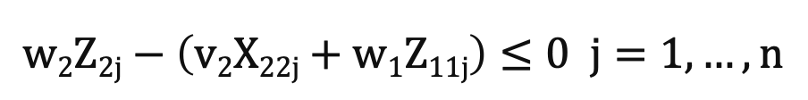
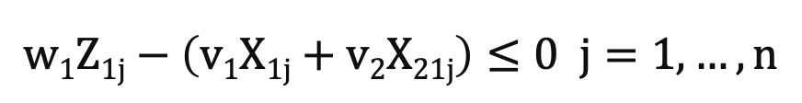
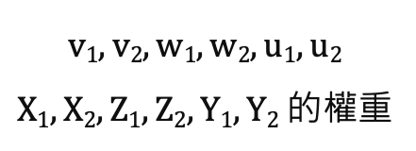
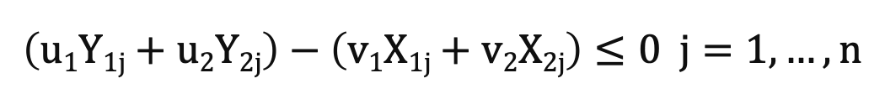
Revised network DEA model
Network DEA in Insurance Industry
(CRS)
$$Max u1Y1k+u2Y2k$$
$s.t.$
$$v1X1k+v2X2k=1$$
$$\left(u1Y1j+u2Y2j\right)−\left(v1X1j+v2X2j\right)≤0 j=1,…,n$$
$$v1, v2, w1, w2, u1, u2$$
$X1, X2, Z1, Z2, Y1, Y2$ 的權重
$$w1Z1j−\left(v1X1j+v2X21j\right)≤0 j=1,…,n$$
$$w2Z2j−\left(v2X22j+w1Z11j\right)≤0 j=1,…,n$$
$$u1Y1j+u2Y2j0−\left(w1Z12j+w2Z2j\right)≤0 j=1,…,n$$
$$v1, v2, w1, w2, u1, u2≥ε$$

Slide 6
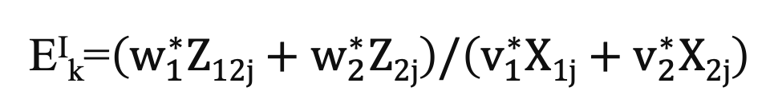
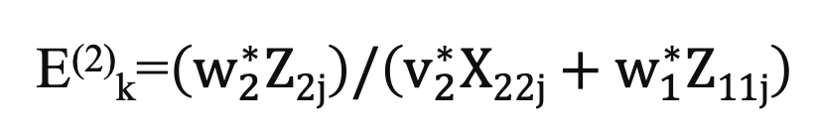
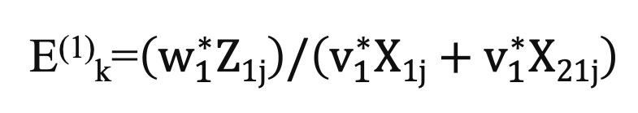
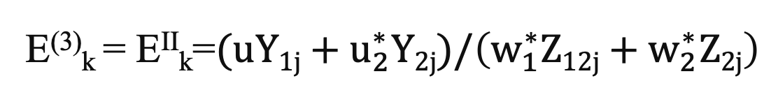
Revised network DEA model
Network DEA in Insurance Industry
(CRS)
E⁽¹⁾_{k}=$\left(w_{1}^{∗}Z1j\right)/\left(v_{1}^{∗}X1j+v_{1}^{∗}X21j\right)$
E⁽²⁾_{k}=$\left(w_{2}^{∗}Z2j\right)/\left(v_{2}^{∗}X22j+w_{1}^{∗}Z11j\right)$
E^{I}_{k}=$\left(w_{1}^{∗}Z12j+w_{2}^{∗}Z2j\right)/\left(v_{1}^{∗}X1j+v_{2}^{∗}X2j\right)$
E⁽³⁾_{k} = E^{II}_{k}=$(uY1j+u_{2}^{∗}Y2j)/\left(w_{1}^{∗}Z12j+w_{2}^{∗}Z2j\right)$

Slide 7
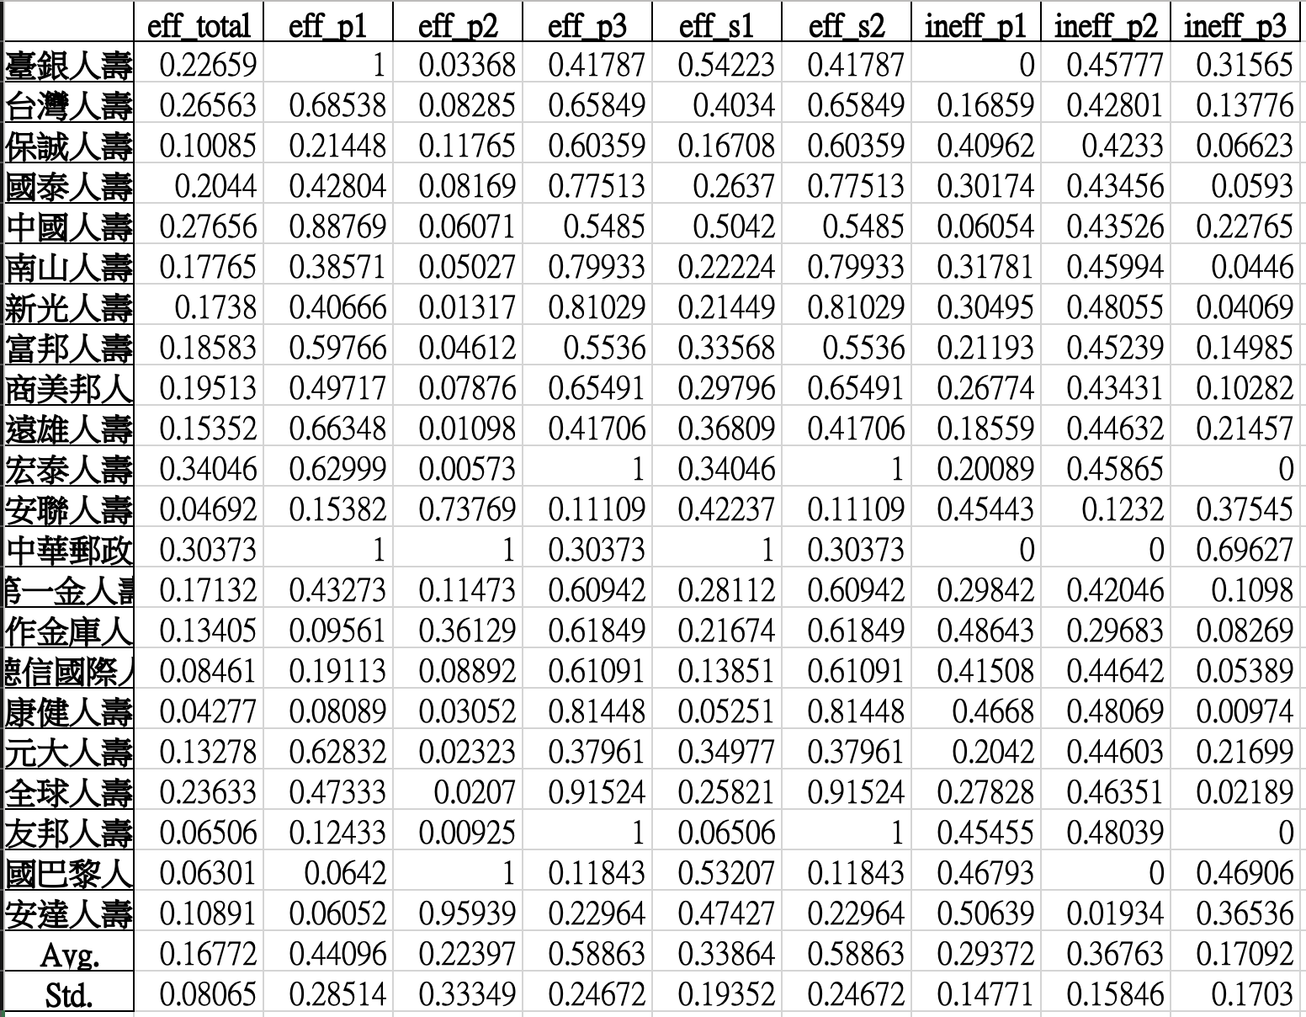
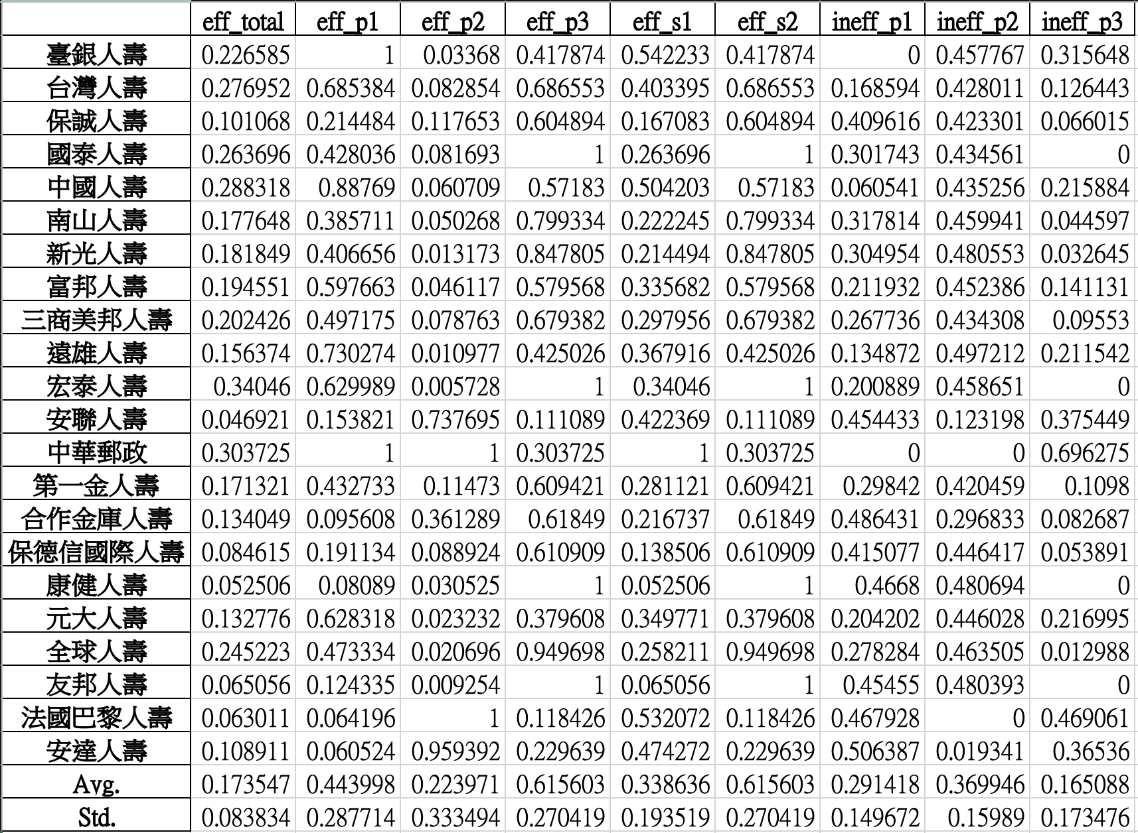
Revised network DEA model
Network DEA in Insurance Industry
after
(CRS)
2019
壽險
產險
效率排名改變
before

Slide 8
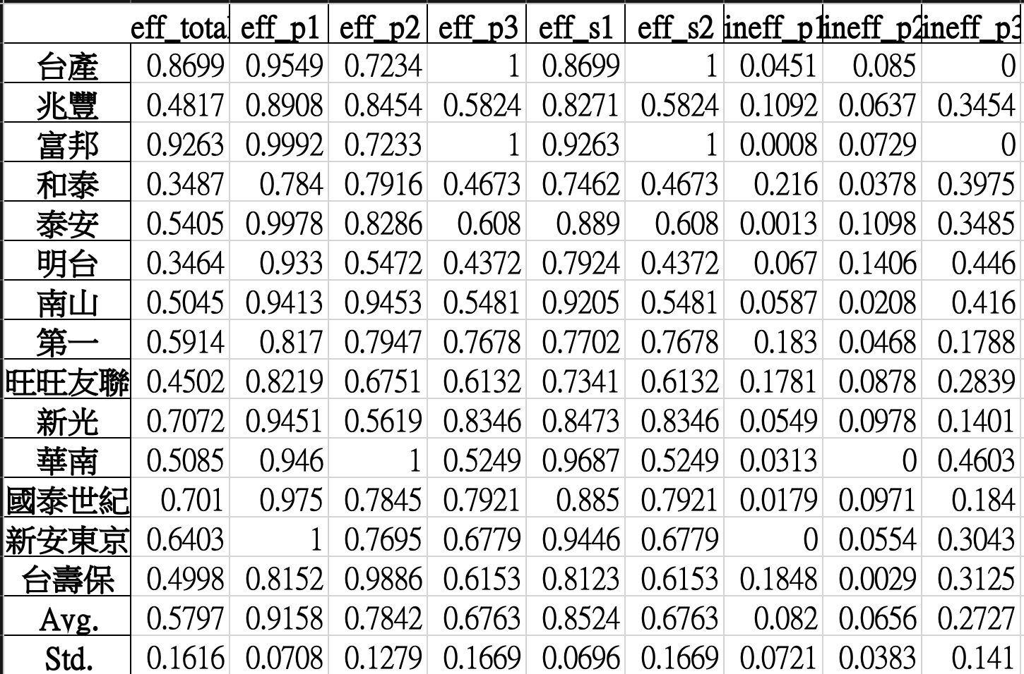
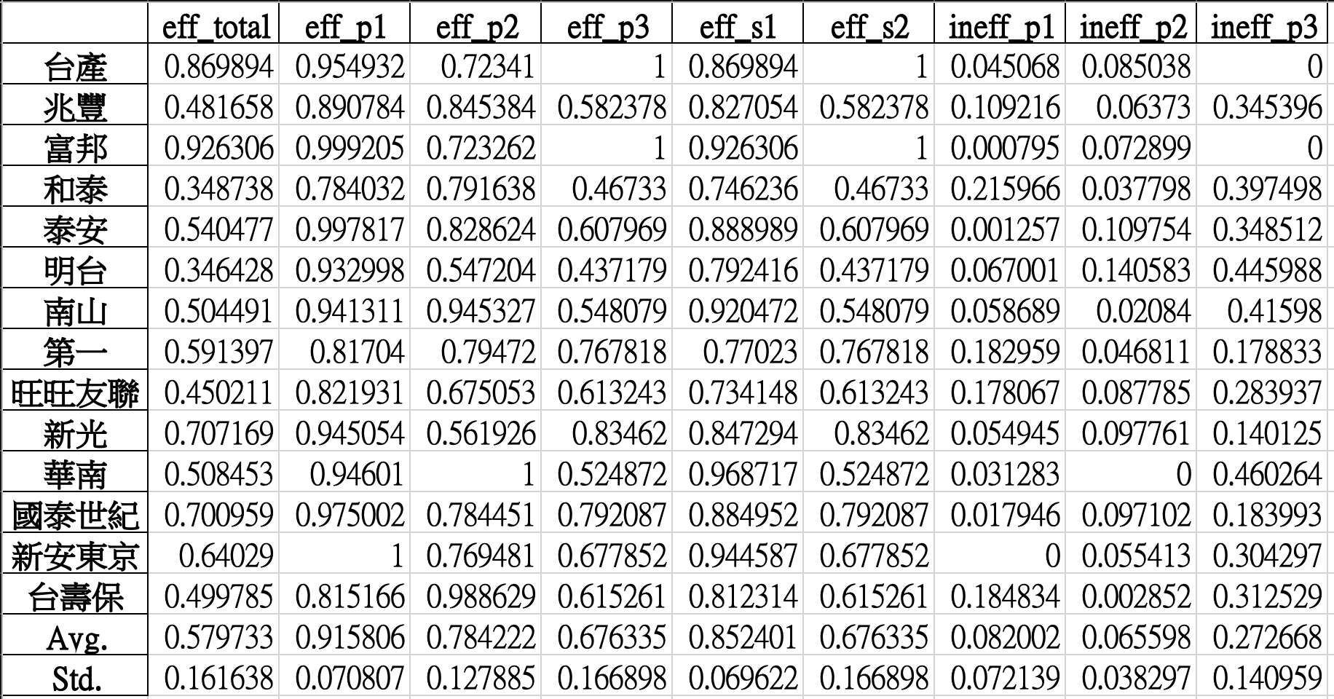
Revised network DEA model
Network DEA in Insurance Industry
(CRS)
after
2019
壽險
產險
無明顯差異
before

Slide 9
產險、壽險 | Z1 no split | Z1 split
CRS
VRS |  | 時間（5 年）

Slide 10
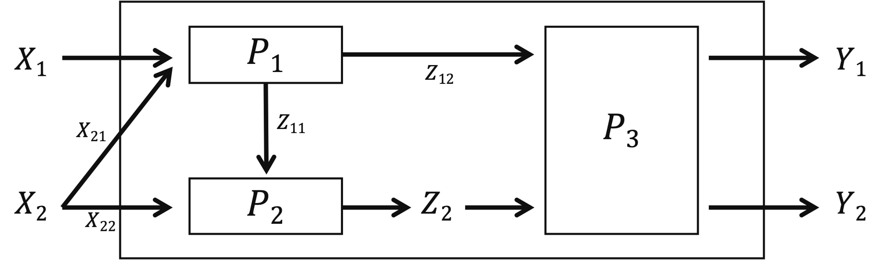
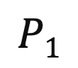
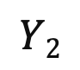
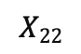
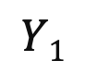
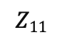
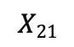
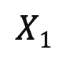
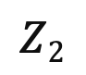
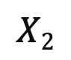
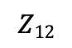
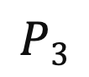
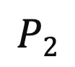
Revised network DEA model
Network DEA in Insurance Industry
(Z1_split CRS)
Notations:
$X1$: Insurance expenses
$X2$: Operation expenses
$X21$: 50% of $X2$
$X22$: 50% of $X2$
$Z1$: Premium income
$Z11$: Premiums ceded to reinsurers
$Z12$: $Z1−Z11$
$Z2$: Reinsurance premiums
$P1$: Direct insurance
$P2$: Reinsurance
$P3$: Profit generation
$Y1$: Underwriting profit
$Y2$: Investment profit
$$X1$$
$$P1$$
$$Y1$$
$$Z12$$
$$X21$$
$$Z11$$
$$P3$$
$$X2$$
$$P2$$
$$Z2$$
$$Y2$$
$$X22$$

Slide 11
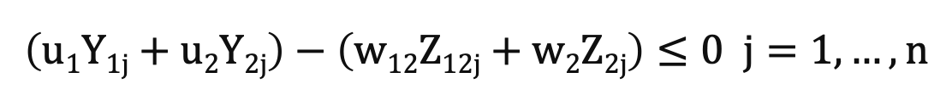
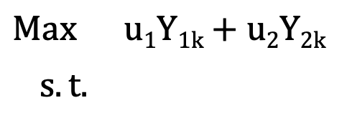



Revised network DEA model
Network DEA in Insurance Industry
(Z1_split CRS)
$$v1, v2, w11, w12, w2,u1, u2$$
$X1, X2, Z1, Z2, Y1, Y2$ 的權重
$$Max u1Y1k+u2Y2k$$
$s.t.$
$$v1X1k+v2X2k=1$$
$$\left(u1Y1j+u2Y2j\right)−\left(v1X1j+v2X2j\right)≤0 j=1,…,n$$
$$\left(w11Z11j+w12Z12j\right)−\left(v1X1j+v2X21j\right)≤0 j=1,…,n$$
$$w2Z2j−\left(v2X22j+w11Z11j\right)≤0 j=1,…,n$$
$$\left(u1Y1j+u2Y2j\right)−\left(w12Z12j+w2Z2j\right)≤0 j=1,…,n$$
$$v1, v2, w1, w2, u1, u2≥ε$$

Slide 12




Revised network DEA model
Network DEA in Insurance Industry
(Z1_split CRS)
E⁽¹⁾_{k}=$\left(w_{11}^{∗}Z11j+w_{12}^{∗}Z12j\right)/\left(v_{1}^{∗}X1j+v_{2}^{∗}X21j\right)$
E⁽²⁾_{k}=$\left(w_{2}^{∗}Z2j\right)/\left(v_{2}^{∗}X22j+w_{11}^{∗}Z11j\right)$
E^{I}_{k}=$\left(w_{12}^{∗}Z12j+w_{2}^{∗}Z2j\right)/\left(v_{1}^{∗}X1j+v_{2}^{∗}X2j\right)$
E⁽³⁾_{k} = E^{II}_{k}=$(u_{1}^{∗}Y1j+u_{2}^{∗}Y2j)/\left(w_{12}^{∗}Z12j+w_{2}^{∗}Z2j\right)$

Slide 13


Revised network DEA model
Network DEA in Insurance Industry
after
(CRS)
2019
壽險
產險
負值有改善
before

Slide 14


Revised network DEA model
Network DEA in Insurance Industry
(Z1_split CRS)
after
2019
壽險
產險
富邦不合理
0 仍存在
before

Slide 15
產險、壽險 | Z1 no split | Z1 split
CRS
VRS |  | 時間（5 年）

Slide 16
Revised network DEA model
Network DEA in Insurance Industry
(VRS input-oriented)
Notations:
$X1$: Insurance expenses
$X2$: Operation expenses
$X21$: 50% of $X2$
$X22$: 50% of $X2$
$Z1$: Premium income
$Z11$: Premiums ceded to reinsurers
$Z12$: $Z1−Z11$
$Z2$: Reinsurance premiums
$P1$: Direct insurance
$P2$: Reinsurance
$P3$: Profit generation
$Y1$: Underwriting profit
$Y2$: Investment profit
$$X1$$
$$P1$$
$$Z1$$
$$Y1$$
$$Z12$$
$$X21$$
$$P3$$
$$Z11$$
$$X2$$
$$P2$$
$$Z2$$
$$Y2$$
$$X22$$

Slide 17



Revised network DEA model
Network DEA in Insurance Industry
(VRS input-oriented)
$$Max u1Y1k+u2Y2k−u0$$
$s.t.$
$$v1X1k+v2X2k=1$$
$$\left(u1Y1j+u2Y2j−u0\right)−\left(v1X1j+v2X2j\right)≤0 j=1,…,n$$
$$v1, v2, w1, w2, u1, u2$$
$X1, X2, Z1, Z2, Y1, Y2$ 的權重
$$w1Z1j−w_{0}^{1}−\left(v1X1j+v2X21j\right)≤0 j=1,…,n$$
$$w2Z2j−w_{0}^{2}−\left(v2X22j+w1Z11j−w_{0}^{1}\right)≤0 j=1,…,n$$
$$w_{0}^{1},w_{0}^{2}, u0$$
Multiplier variables
$$u1Y1j+u2Y2j−u0−\left(w1Z12j+w2Z2j−w_{0}^{1}−w_{0}^{2}\right)≤0 j=1,…,n$$
$$v1, v2, w1, w2, u1, u2≥ε$$

Slide 18



Revised network DEA model
Network DEA in Insurance Industry
(VRS input-oriented)
E⁽¹⁾_{k}=$\left(w_{1}^{∗}Z1j−w_{0}^{1∗}\right)/\left(v_{1}^{∗}X1j+v_{1}^{∗}X21j\right)$
E⁽²⁾_{k}=$\left(w_{2}^{∗}Z2j−w_{0}^{2∗}\right)/\left(v_{2}^{∗}X22j+w_{1}^{∗}Z11j−w_{0}^{1∗}\right)$
E^{I}_{k}=$\left(w_{1}^{∗}Z12j−w_{0}^{1∗}+w_{2}^{∗}Z2j−w_{0}^{2∗}\right)/\left(v_{1}^{∗}X1j+v_{2}^{∗}X2j\right)$
E⁽³⁾_{k} = E^{II}_{k}=$(uY1j+u_{2}^{∗}Y2j−u_{0}^{∗})/\left(w_{1}^{∗}Z12j−w_{0}^{1∗}+w_{2}^{∗}Z2j−w_{0}^{2∗}\right)$

Slide 19


after
Revised network DEA model
Network DEA in Insurance Industry
(CRS)
2019
壽險
產險
國泰、南山分數暴跌
富邦分數不合理
before

Slide 20


Revised network DEA model
Network DEA in Insurance Industry
(VRS input-oriented)
after
2019
壽險
產險
整體排名不變
before

Slide 21
產險、壽險 | Z1 no split | Z1 split
CRS
VRS |  | 時間（5 年）

Slide 22
Revised network DEA model
Network DEA in Insurance Industry
(Z1_split VRS input-oriented)
Notations:
$X1$: Insurance expenses
$X2$: Operation expenses
$X21$: 50% of $X2$
$X22$: 50% of $X2$
$Z1$: Premium income
$Z11$: Premiums ceded to reinsurers
$Z12$: $Z1−Z11$
$Z2$: Reinsurance premiums
$P1$: Direct insurance
$P2$: Reinsurance
$P3$: Profit generation
$Y1$: Underwriting profit
$Y2$: Investment profit
$$X1$$
$$P1$$
$$Y1$$
$$Z12$$
$$X21$$
$$Z11$$
$$P3$$
$$X2$$
$$P2$$
$$Z2$$
$$Y2$$
$$X22$$

Slide 23



Revised network DEA model
Network DEA in Insurance Industry
(Z1_split VRS input-oriented)
$$Max u1Y1k+u2Y2k−u0$$
$s.t.$
$$v1X1k+v2X2k=1$$
$$\left(u1Y1j+u2Y2j−u0\right)−\left(v1X1j+v2X2j\right)≤0 j=1,…,n$$
$$v1, v2, w11, w12, w2,u1, u2$$
$X1, X2, Z1, Z2, Y1, Y2$ 的權重
$$\left(w11Z11j+w12Z12j−w_{0}^{1}\right)−\left(v1X1j+v2X21j\right)≤0 j=1,…,n$$
$$w2Z2j−w_{0}^{2}−\left(v2X22j+w11Z11j−w_{0}^{1}\right)≤0 j=1,…,n$$
$$w_{0}^{1},w_{0}^{2}, u0$$
Multiplier variables
$$\left(u1Y1j+u2Y2j−u0\right)−\left(w12Z12j−w_{0}^{1}+w2Z2j−w_{0}^{2}\right)≤0 j=1,…,n$$
$$v1, v2, w1, w2, u1, u2≥ε$$

Slide 24



Revised network DEA model
Network DEA in Insurance Industry
(Z1_split VRS input-oriented)
E⁽¹⁾_{k}=$\left(w_{11}^{∗}Z11j+w_{12}^{∗}Z12j−w_{0}^{1∗}\right)/\left(v_{1}^{∗}X1j+v_{2}^{∗}X21j\right)$
E⁽²⁾_{k}=$\left(w_{2}^{∗}Z2j−w_{0}^{2∗}\right)/\left(v_{2}^{∗}X22j+w_{11}^{∗}Z11j−w_{0}^{1∗}\right)$
E^{I}_{k}=$\left(w_{12}^{∗}Z12j−w_{0}^{1∗}+w_{2}^{∗}Z2j−w_{0}^{2∗}\right)/\left(v_{1}^{∗}X1j+v_{2}^{∗}X2j\right)$
E⁽³⁾_{k} = E^{II}_{k}=$(u_{1}^{∗}Y1j+u_{2}^{∗}Y2j−u_{0}^{∗})/\left(w_{12}^{∗}Z12j−w_{0}^{1∗}+w_{2}^{∗}Z2j−w_{0}^{2∗}\right)$

Slide 25


Revised network DEA model
after
Network DEA in Insurance Industry
(CRS)
2019
壽險
產險
國泰、南山分數暴跌
富邦分數不合理
before

Slide 26


Revised network DEA model
Network DEA in Insurance Industry
(Z1_split VRS input-oriented)
2019
壽險
產險
after
富邦不合理
0 仍存在
before

Slide 27

Network DEA in Insurance Industry
保險業務會影響再保分保業務
理賠與投資同時進行

